Slide 1
Engineering Drawing & Graphics
Engineering Drawing & CAD
Lecture 6
Projection of Solids
by
Umer Farooq
may, 2019

Slide 2
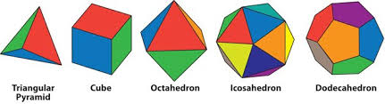
PROJECTIONS OF SOLIDS
TYPES OF SOLIDS
  POLYHEDRA
  A solid that has all faces as flat surfaces and are polygons.
      Regular Polyhedra
  All faces shall be regular polygons of the same size and shape, and the solid itself shall be symmetrical all around.
        Tetrahedron has 4 equilateral triangles of the same size
        Hexahedron (cube) has 6 equal squares
        Octahedron has 8 equilateral triangles of the same size
        Dodecahedron has 12 regular pentagons of the same size
        Icosahedron has 20 equilateral triangles of the same size

Slide 3
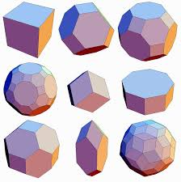
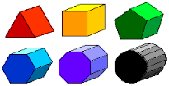
      B. Irregular Polyhedra
  At least one face is either an irregular polygon or a different shaped polygon than the other faces.
        Prisms
        Has two similar polygons of the same size and parallel to one another as bases, the corresponding sides of which are connected by means of parallelograms.

Slide 4
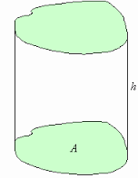
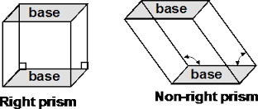
        A regular prism is the one that has regular polygons as bases.
        An irregular prism is the one that has irregular polygons as bases.
        A right prism is the one that has the axis perpendicular to the bases.
        An oblique prism is the one that has the axis inclined to the bases.

Slide 5

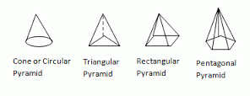
        Pyramids
        Has on polygon as a base, the sides of which are connected to triangles that are also joined together side by side and have one common apex.

Slide 6
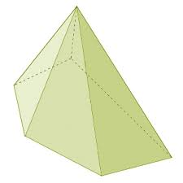
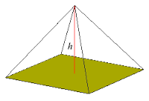
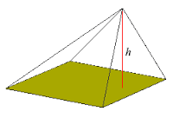
        A regular pyramid is the one that has a regular polygon as base.
        An irregular pyramid is the one that has an irregular polygon as base.
        A right pyramid is the one that has the axis perpendicular to the base.
        An oblique pyramid is the one that has the axis inclined to the base.
Irregular pyramid
Regular, right pyramid
oblique pyramid

Slide 7
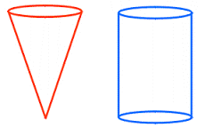
  SOLIDS OF REVOLUTION
  Solid that are generated by rotating a plane about a line for one revolution.
      Cylinder:
      Generated by rotating a rectangle about one of its side for one complete revolution. Has two flat and one single curved surface.
      Cone:
      Generated by rotating a right angled triangle about one of its perpendicular arms for one complete revolution. Has one flat and one single curved surface. Straight lines drawn from the apex to the circumference of the base-circle are all equal and are called generators. Its length is the slant height of cone.
      Sphere:
      Generated by rotating a semi-circle about its diameter for one complete revolution. Has a double curved surface only.

Slide 8
POSSIBLE POSITIONS
  Position of Axis w.r.t. H.P.
    Parallel to the H.P.
    Perpendicular to the H.P.
    Inclined to the H.P.
  Position of Axis w.r.t. V.P.
    Parallel to the V.P.
    Perpendicular to the V.P.
    Inclined to the V.P.

Slide 9
POSITIONS OF A SOLID WITH RESPECT TO THE TWO PLANES
Axis parallel to both planes
Axis perpendicular to one plane (must be parallel to the other plane)
    Axis perpendicular to the H.P. (must be parallel to the V.P.)
    Axis perpendicular to the V.P. (must be parallel to the H.P.)
Axis Inclined to one plane and parallel to the other plane
    Axis inclined to the H.P. and parallel to the V.P.
    Axis inclined to the V.P. and parallel to the H.P.
Axis inclined to both planes

Slide 10
ALWAYS DRAW THE VIEW IN
WHICH THE TRUE SIZE AND
SHAPE OF THE BASE IS SEEN

Slide 11
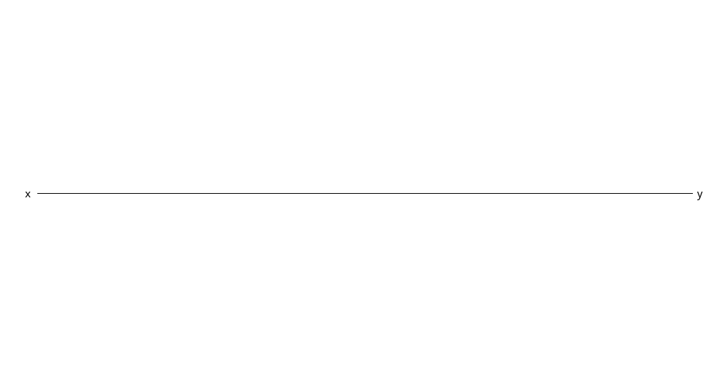
Example 1:
A pentagonal prism of 25 mm side of base and axis 50 mm long, has its axis parallel to both the planes. One rectangular face of the prism makes an angle of 30º with the V.P. Draw its projections.

Slide 12
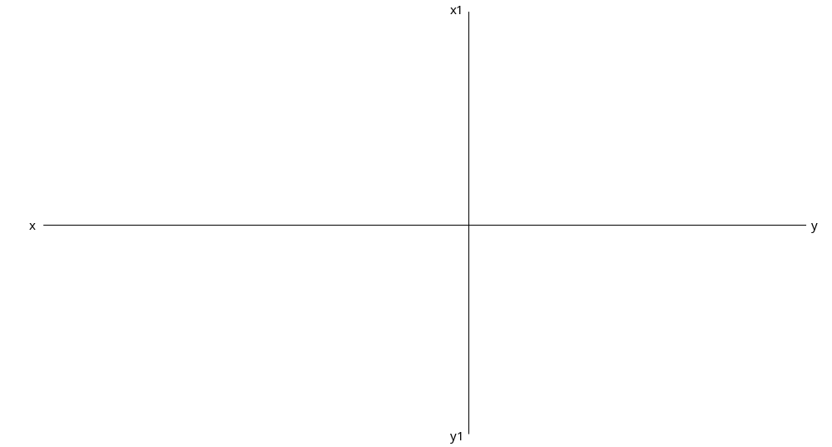
Example 1:
A pentagonal prism of 25 mm side of base and axis 50 mm long, has its axis parallel to both the planes. One rectangular face of the prism makes an angle of 30º with the V.P. Draw its projections.

Slide 13
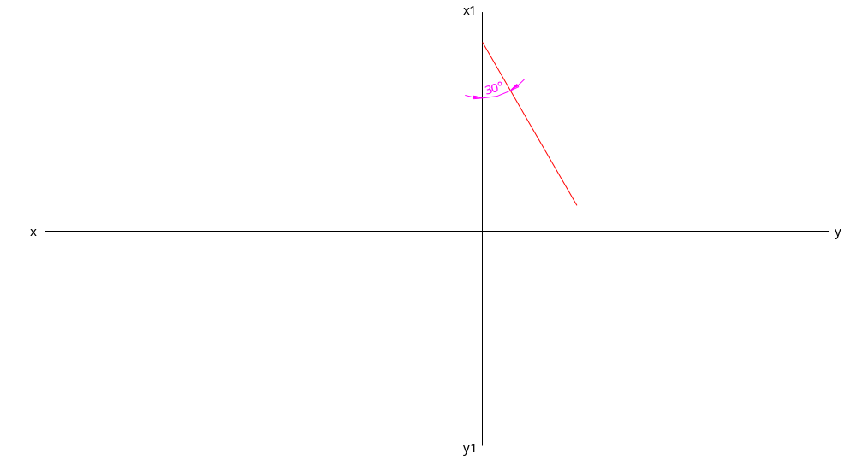
Example 1:
A pentagonal prism of 25 mm side of base and axis 50 mm long, has its axis parallel to both the planes. One rectangular face of the prism makes an angle of 30º with the V.P. Draw its projections.

Slide 14
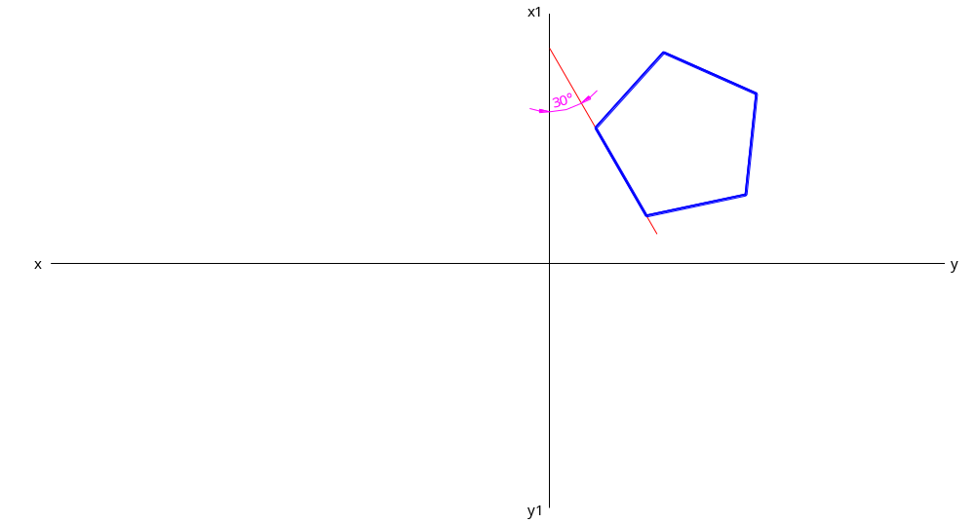
Example 1:
A pentagonal prism of 25 mm side of base and axis 50 mm long, has its axis parallel to both the planes. One rectangular face of the prism makes an angle of 30º with the V.P. Draw its projections.

Slide 15
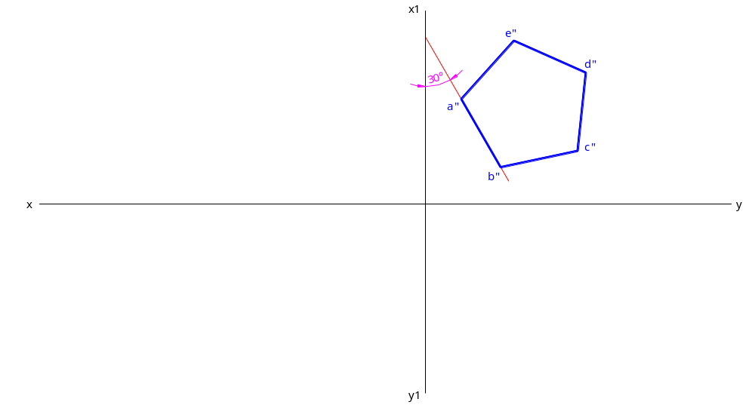
Example 1:
A pentagonal prism of 25 mm side of base and axis 50 mm long, has its axis parallel to both the planes. One rectangular face of the prism makes an angle of 30º with the V.P. Draw its projections.

Slide 16

Example 1:
A pentagonal prism of 25 mm side of base and axis 50 mm long, has its axis parallel to both the planes. One rectangular face of the prism makes an angle of 30º with the V.P. Draw its projections.

Slide 17
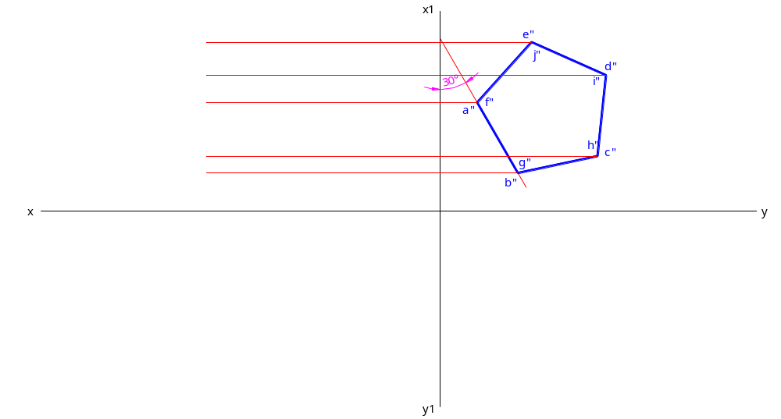
Example 1:
A pentagonal prism of 25 mm side of base and axis 50 mm long, has its axis parallel to both the planes. One rectangular face of the prism makes an angle of 30º with the V.P. Draw its projections.

Slide 18
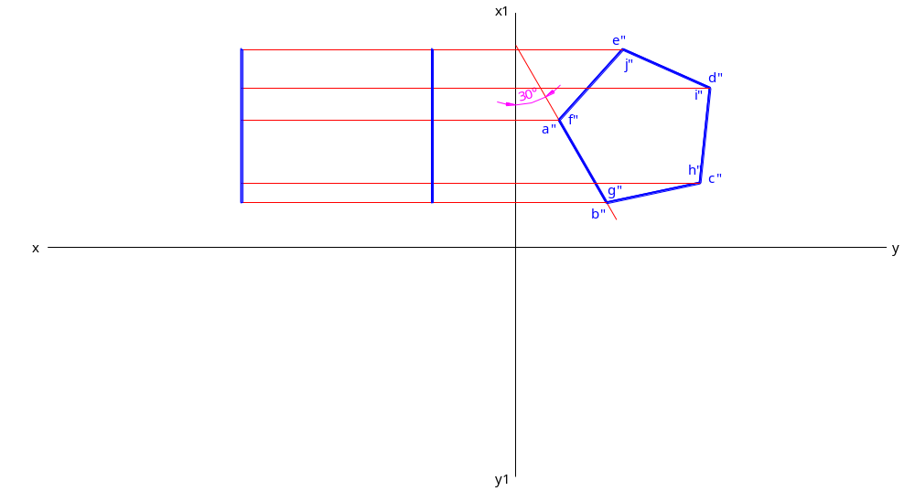
Example 1:
A pentagonal prism of 25 mm side of base and axis 50 mm long, has its axis parallel to both the planes. One rectangular face of the prism makes an angle of 30º with the V.P. Draw its projections.

Slide 19
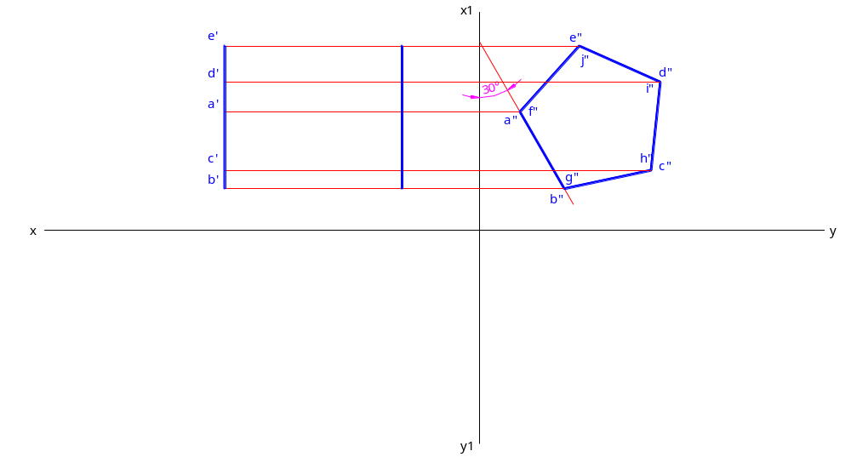
Example 1:
A pentagonal prism of 25 mm side of base and axis 50 mm long, has its axis parallel to both the planes. One rectangular face of the prism makes an angle of 30º with the V.P. Draw its projections.

Slide 20
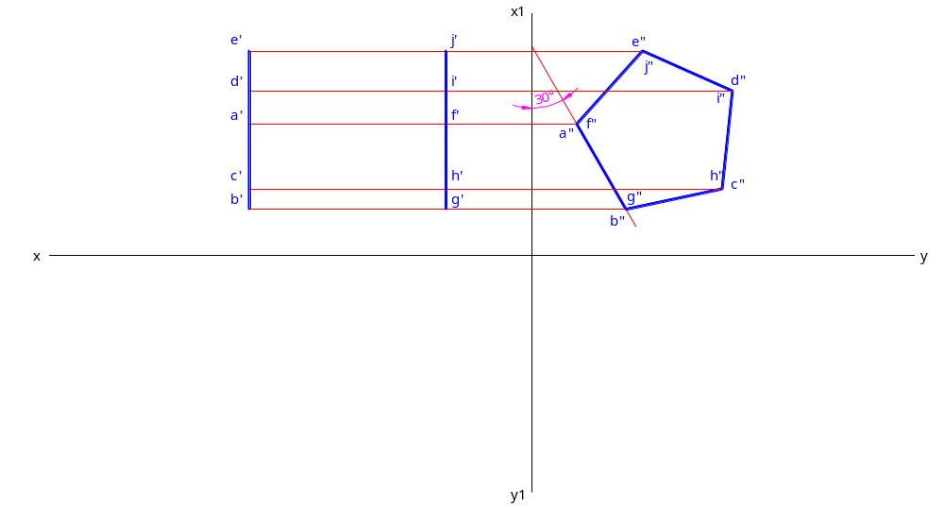
Example 1:
A pentagonal prism of 25 mm side of base and axis 50 mm long, has its axis parallel to both the planes. One rectangular face of the prism makes an angle of 30º with the V.P. Draw its projections.

Slide 21
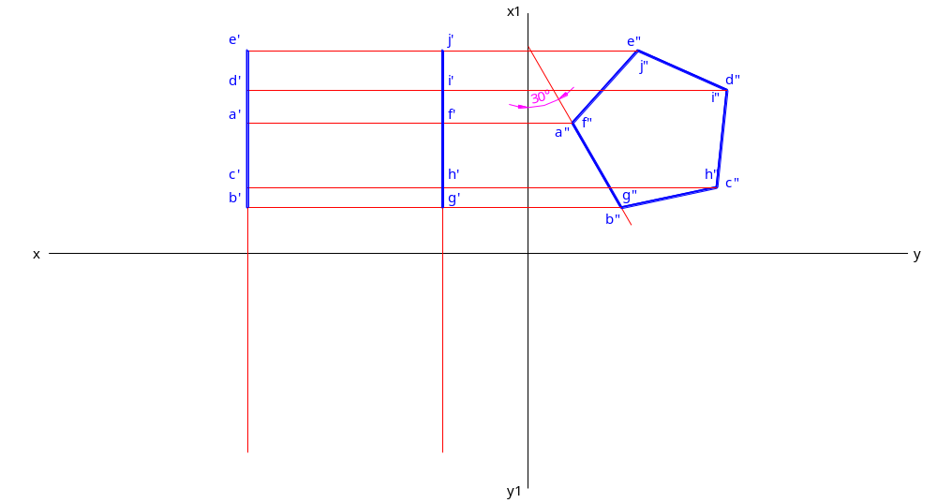
Example 1:
A pentagonal prism of 25 mm side of base and axis 50 mm long, has its axis parallel to both the planes. One rectangular face of the prism makes an angle of 30º with the V.P. Draw its projections.

Slide 22
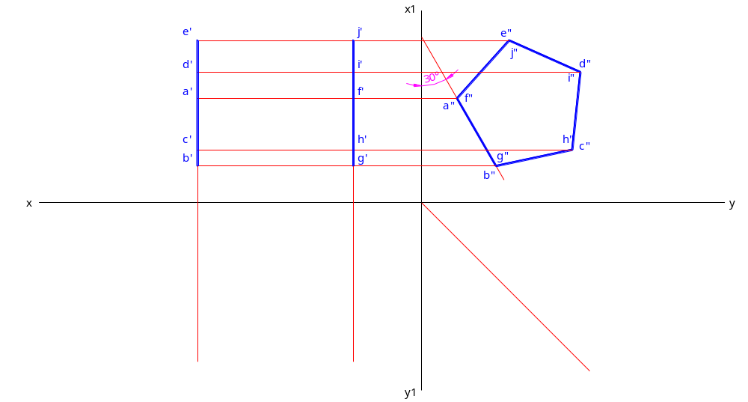
Example 1:
A pentagonal prism of 25 mm side of base and axis 50 mm long, has its axis parallel to both the planes. One rectangular face of the prism makes an angle of 30º with the V.P. Draw its projections.

Slide 23
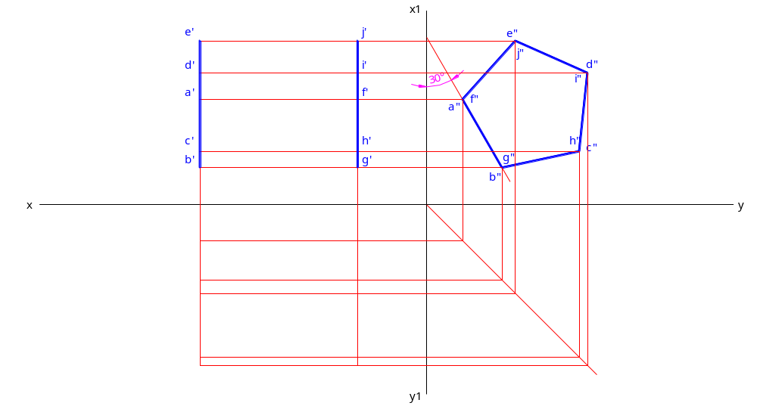
Example 1:
A pentagonal prism of 25 mm side of base and axis 50 mm long, has its axis parallel to both the planes. One rectangular face of the prism makes an angle of 30º with the V.P. Draw its projections.

Slide 24
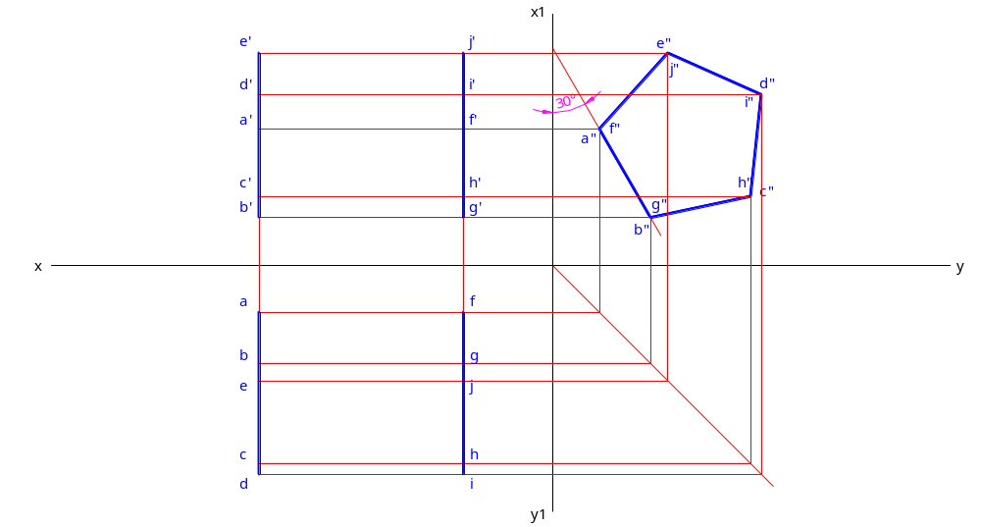
Example 1:
A pentagonal prism of 25 mm side of base and axis 50 mm long, has its axis parallel to both the planes. One rectangular face of the prism makes an angle of 30º with the V.P. Draw its projections.

Slide 25
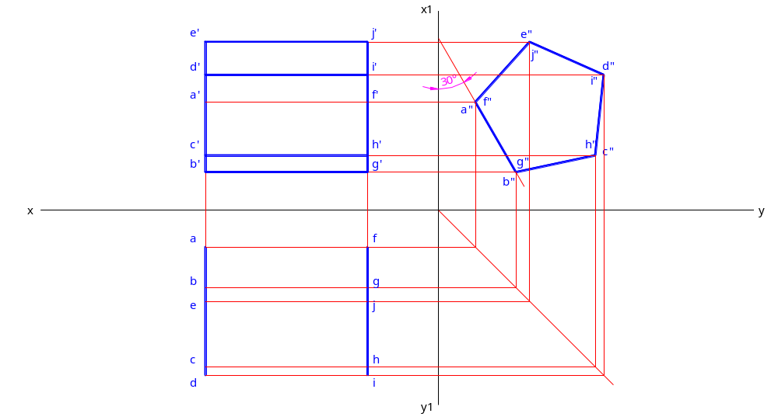
Example 1:
A pentagonal prism of 25 mm side of base and axis 50 mm long, has its axis parallel to both the planes. One rectangular face of the prism makes an angle of 30º with the V.P. Draw its projections.

Slide 26

Example 1:
A pentagonal prism of 25 mm side of base and axis 50 mm long, has its axis parallel to both the planes. One rectangular face of the prism makes an angle of 30º with the V.P. Draw its projections.

Slide 27
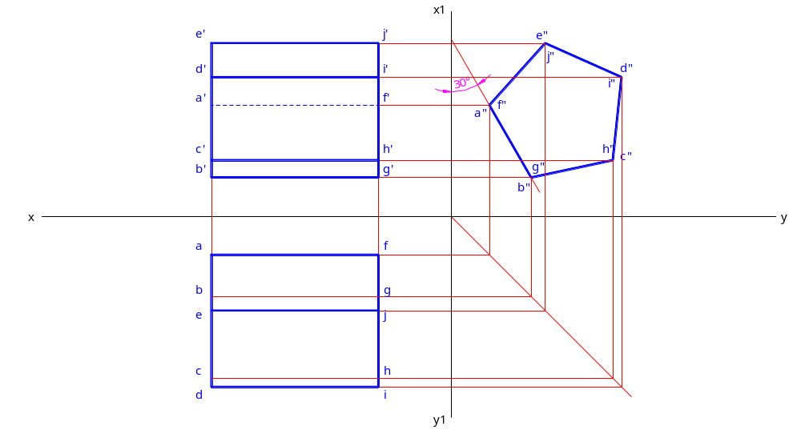
Example 1:
A pentagonal prism of 25 mm side of base and axis 50 mm long, has its axis parallel to both the planes. One rectangular face of the prism makes an angle of 30º with the V.P. Draw its projections.

Slide 28
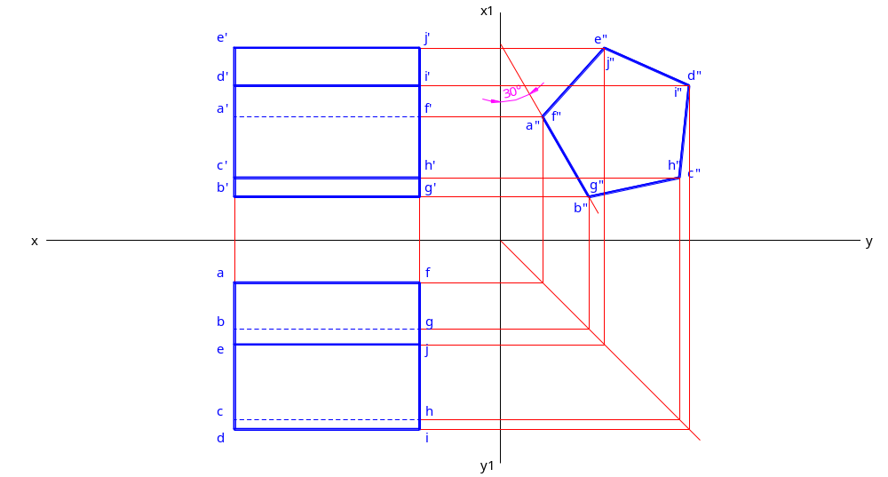
Example 1:
A pentagonal prism of 25 mm side of base and axis 50 mm long, has its axis parallel to both the planes. One rectangular face of the prism makes an angle of 30º with the V.P. Draw its projections.

Slide 29
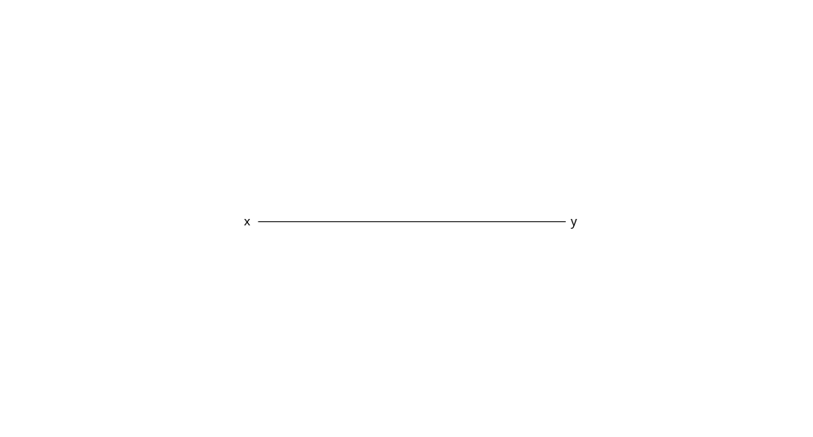
Example 2:
A pentagonal prism of 25 mm side of base and axis 50 mm long, has its base in the H.P. One rectangular face of the prism is perpendicular to the V.P. Draw its projections.

Slide 30
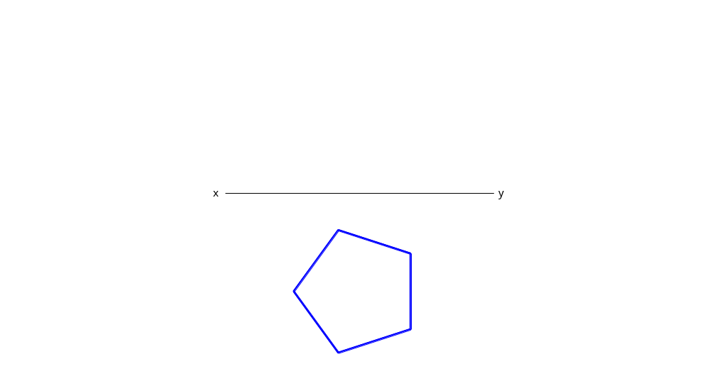
Example 2:
A pentagonal prism of 25 mm side of base and axis 50 mm long, has its base in the H.P. One rectangular face of the prism is perpendicular to the V.P. Draw its projections.

Slide 31
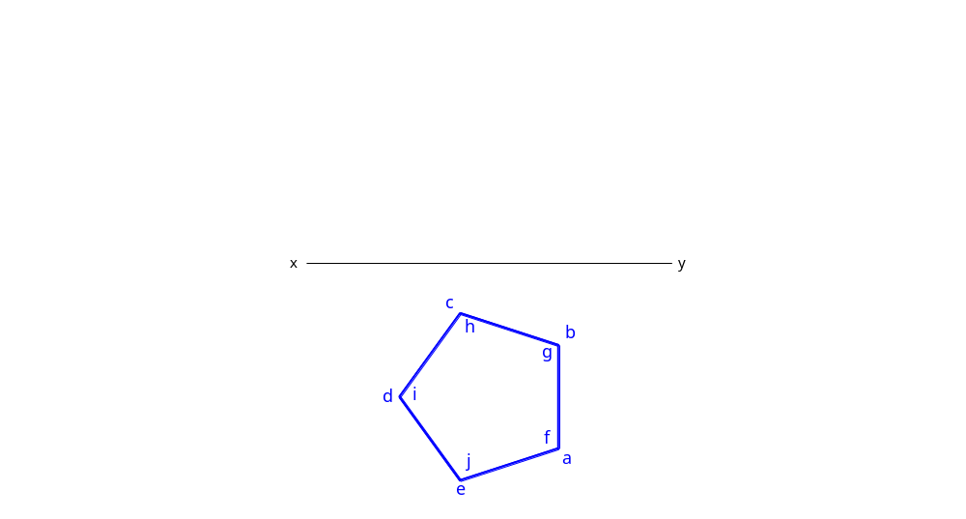
Example 2:
A pentagonal prism of 25 mm side of base and axis 50 mm long, has its base in the H.P. One rectangular face of the prism is perpendicular to the V.P. Draw its projections.

Slide 32
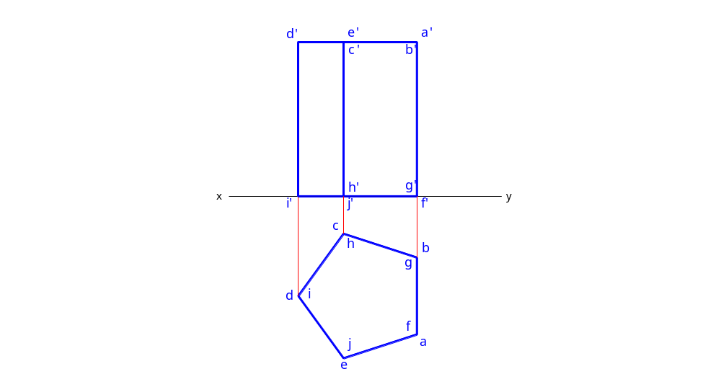
Example 2:
A pentagonal prism of 25 mm side of base and axis 50 mm long, has its base in the H.P. One rectangular face of the prism is perpendicular to the V.P. Draw its projections.

Slide 33
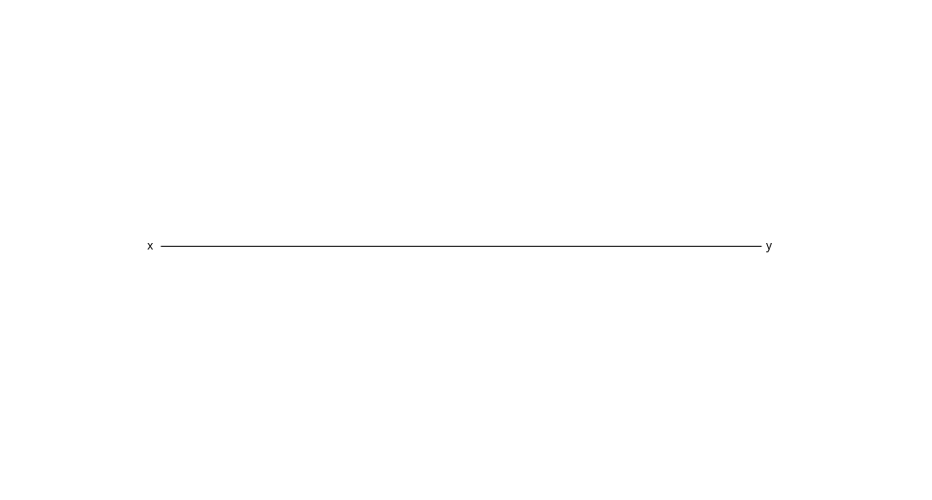
Example 3:
A pentagonal prism of 25 mm side of base and axis 50 mm long, has a side of base in the H.P. The axis of the prism is inclined at 45º to the H.P. and parallel to the V.P. Draw its projections.

Slide 34
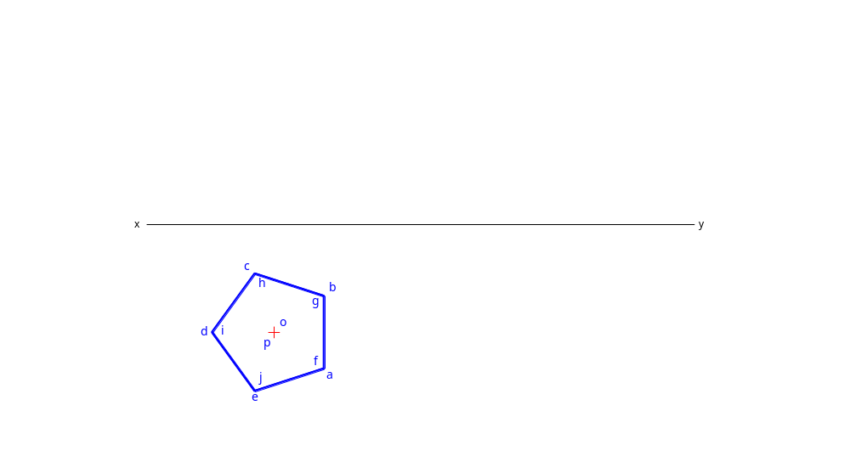
Example 3:
A pentagonal prism of 25 mm side of base and axis 50 mm long, has a side of base in the H.P. The axis of the prism is inclined at 45º to the H.P. and parallel to the V.P. Draw its projections.

Slide 35
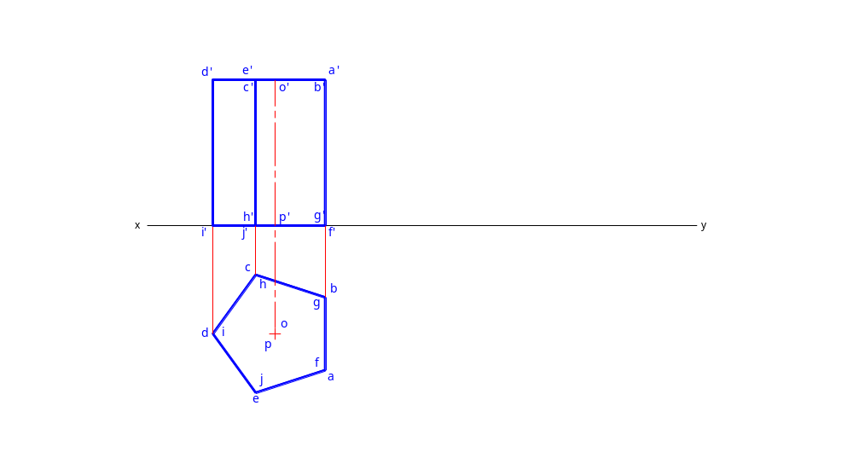
Example 3:
A pentagonal prism of 25 mm side of base and axis 50 mm long, has a side of base in the H.P. The axis of the prism is inclined at 45º to the H.P. and parallel to the V.P. Draw its projections.

Slide 36
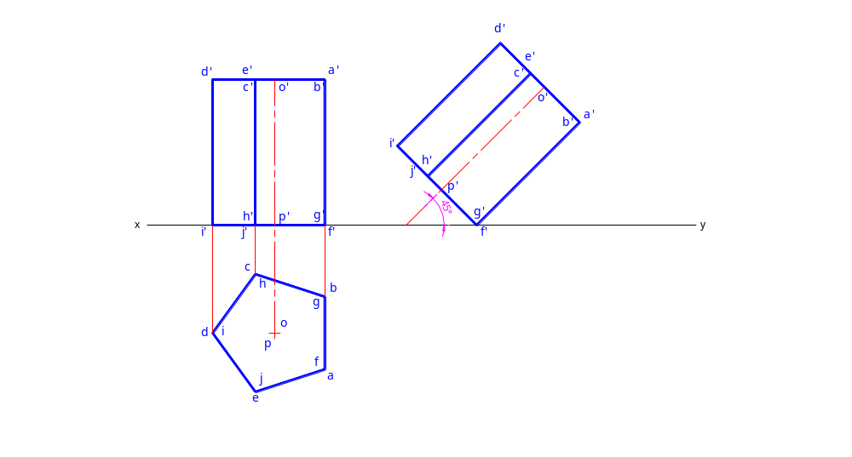
Example 3:
A pentagonal prism of 25 mm side of base and axis 50 mm long, has a side of base in the H.P. The axis of the prism is inclined at 45º to the H.P. and parallel to the V.P. Draw its projections.

Slide 37
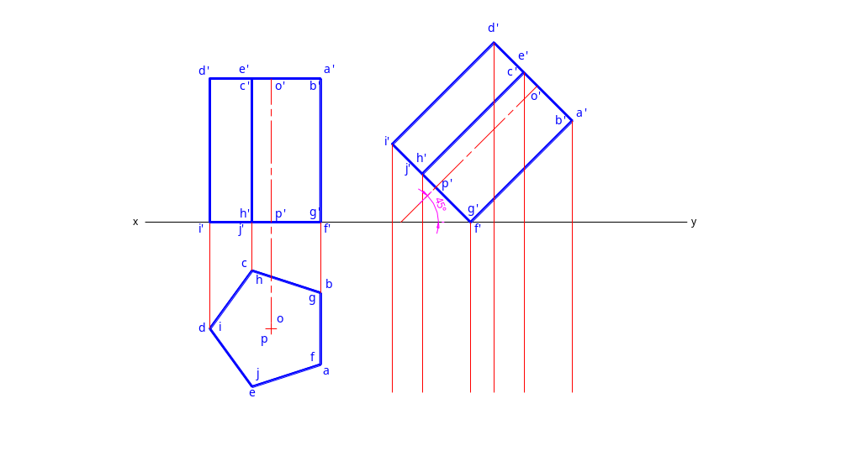
Example 3:
A pentagonal prism of 25 mm side of base and axis 50 mm long, has a side of base in the H.P. The axis of the prism is inclined at 45º to the H.P. and parallel to the V.P. Draw its projections.

Slide 38
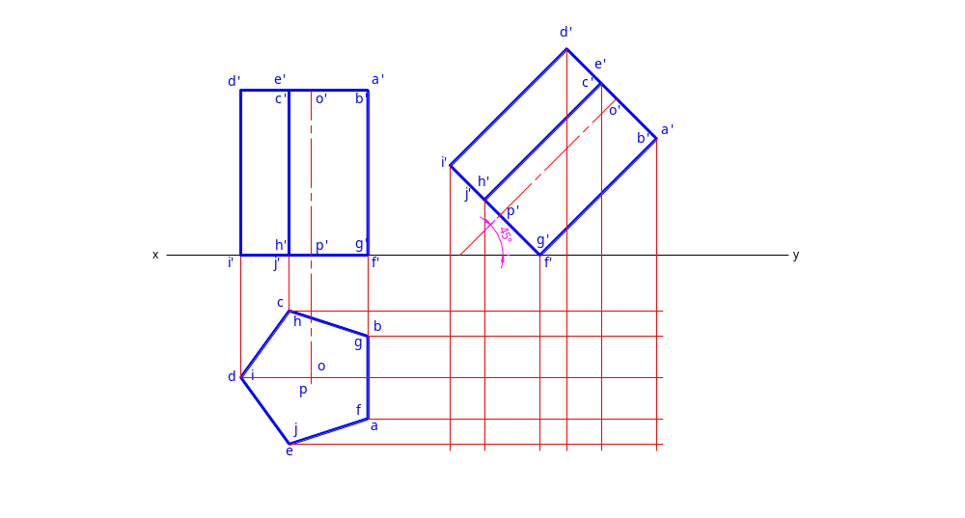
Example 3:
A pentagonal prism of 25 mm side of base and axis 50 mm long, has a side of base in the H.P. The axis of the prism is inclined at 45º to the H.P. and parallel to the V.P. Draw its projections.

Slide 39

Example 3:
A pentagonal prism of 25 mm side of base and axis 50 mm long, has a side of base in the H.P. The axis of the prism is inclined at 45º to the H.P. and parallel to the V.P. Draw its projections.

Slide 40
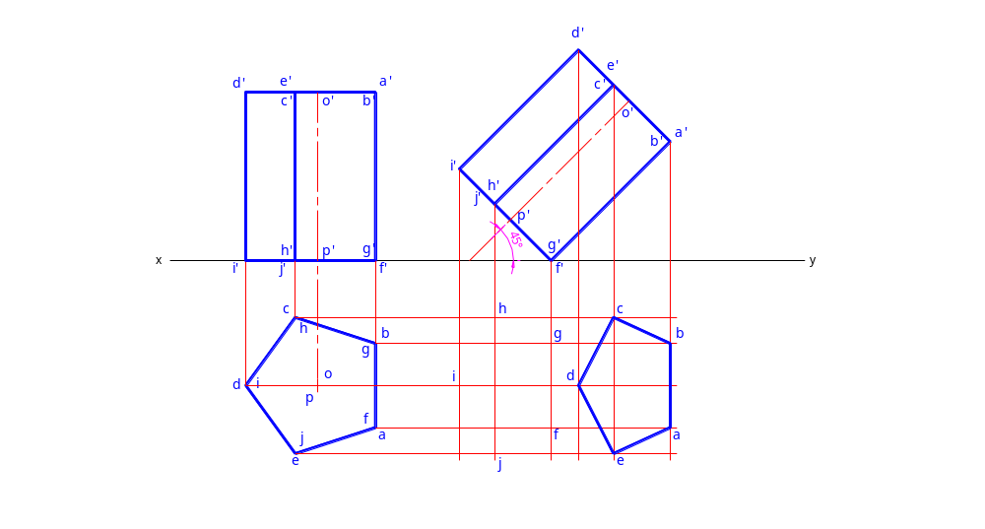
Example 3:
A pentagonal prism of 25 mm side of base and axis 50 mm long, has a side of base in the H.P. The axis of the prism is inclined at 45º to the H.P. and parallel to the V.P. Draw its projections.

Slide 41
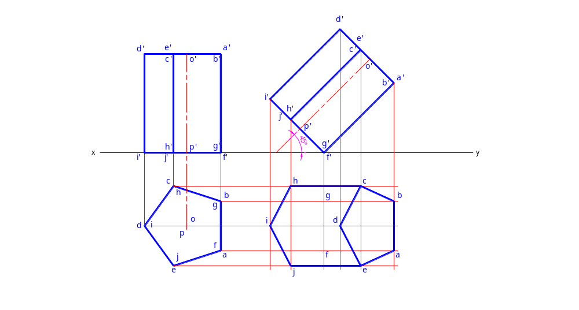
Example 3:
A pentagonal prism of 25 mm side of base and axis 50 mm long, has a side of base in the H.P. The axis of the prism is inclined at 45º to the H.P. and parallel to the V.P. Draw its projections.

Slide 42
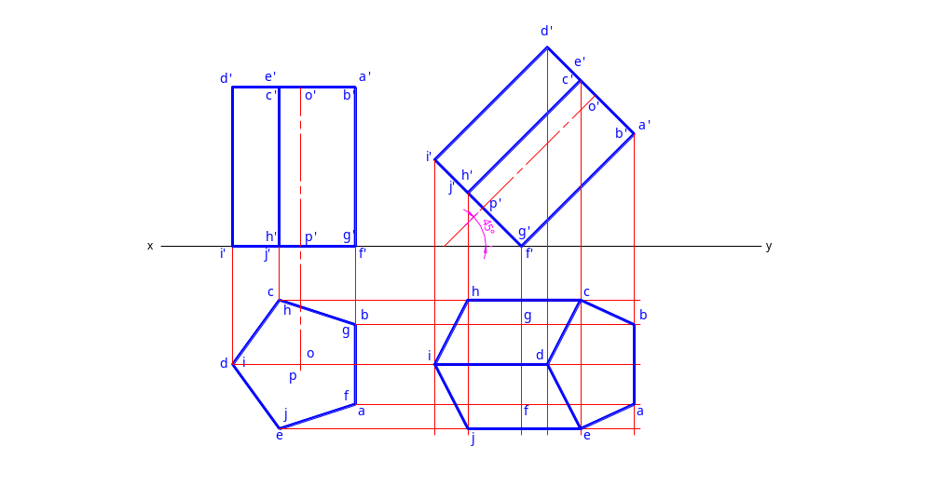
Example 3:
A pentagonal prism of 25 mm side of base and axis 50 mm long, has a side of base in the H.P. The axis of the prism is inclined at 45º to the H.P. and parallel to the V.P. Draw its projections.

Slide 43
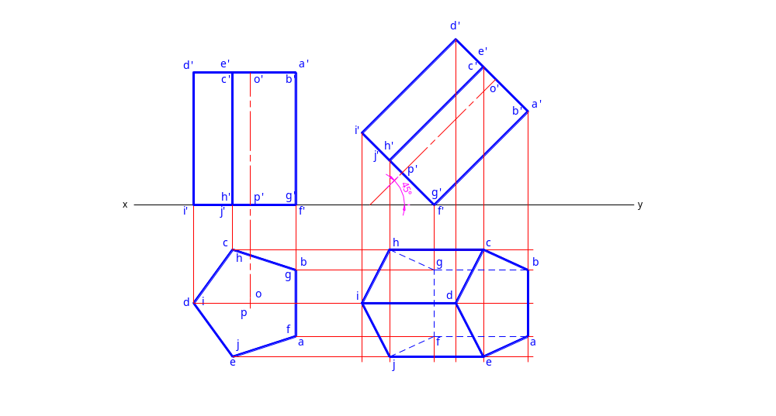
Example 3:
A pentagonal prism of 25 mm side of base and axis 50 mm long, has a side of base in the H.P. The axis of the prism is inclined at 45º to the H.P. and parallel to the V.P. Draw its projections.

Slide 44

Example 3:
A pentagonal prism of 25 mm side of base and axis 50 mm long, has a side of base in the H.P. The axis of the prism is inclined at 45º to the H.P. and parallel to the V.P. Draw its projections.

Slide 45
Example 4:
A pentagonal prism of 25 mm side of base and axis 50 mm long, has a side of base in the H.P. and inclined at 60º to the V.P. The axis of the prism is inclined at 45º to the H.P. Draw its projections.

Slide 46

Example 4:
A pentagonal prism of 25 mm side of base and axis 50 mm long, has a side of base in the H.P. and inclined at 60º to the V.P. The axis of the prism is inclined at 45º to the H.P. Draw its projections.

Slide 47
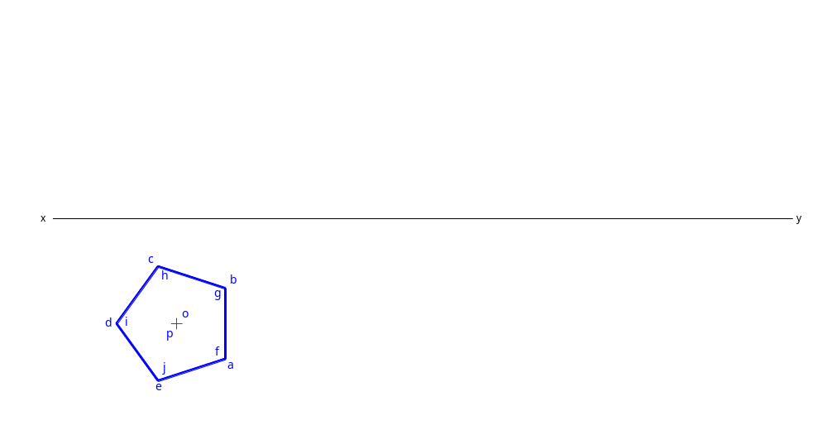
Example 4:
A pentagonal prism of 25 mm side of base and axis 50 mm long, has a side of base in the H.P. and inclined at 60º to the V.P. The axis of the prism is inclined at 45º to the H.P. Draw its projections.

Slide 48
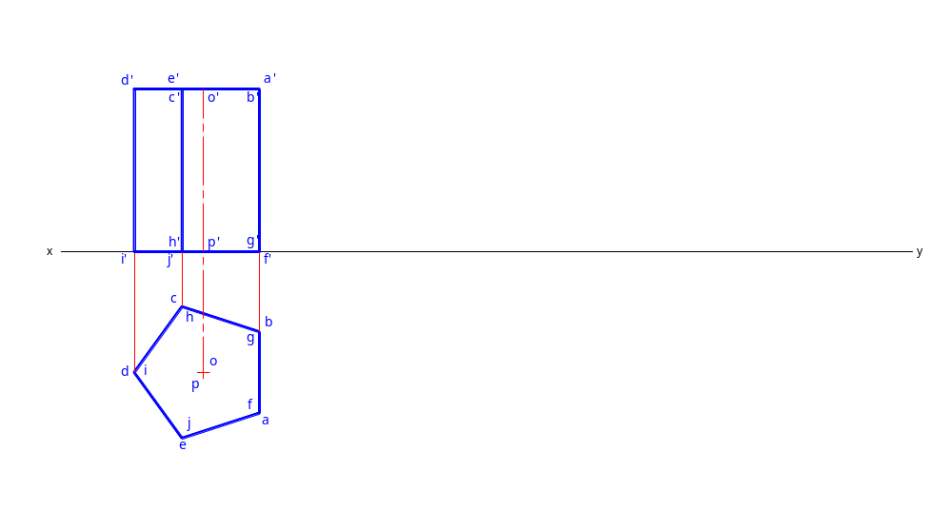
Example 4:
A pentagonal prism of 25 mm side of base and axis 50 mm long, has a side of base in the H.P. and inclined at 60º to the V.P. The axis of the prism is inclined at 45º to the H.P. Draw its projections.

Slide 49
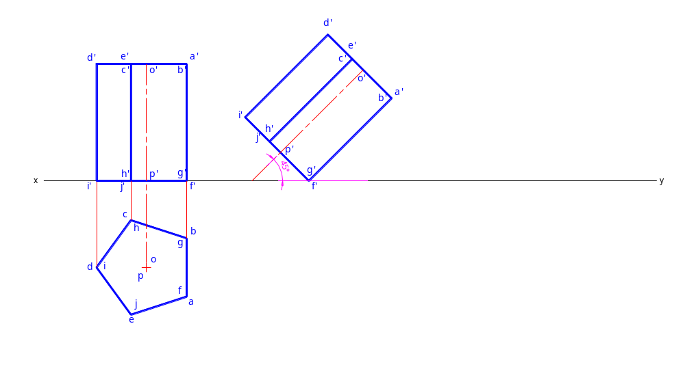
Example 4:
A pentagonal prism of 25 mm side of base and axis 50 mm long, has a side of base in the H.P. and inclined at 60º to the V.P. The axis of the prism is inclined at 45º to the H.P. Draw its projections.

Slide 50
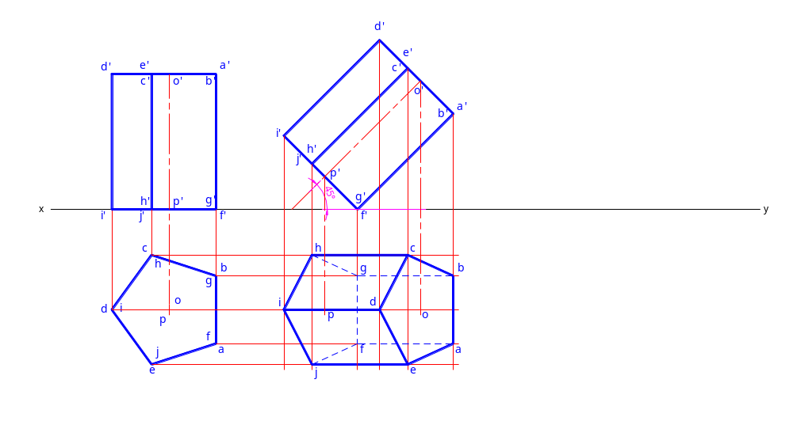
Example 4:
A pentagonal prism of 25 mm side of base and axis 50 mm long, has a side of base in the H.P. and inclined at 60º to the V.P. The axis of the prism is inclined at 45º to the H.P. Draw its projections.

Slide 51
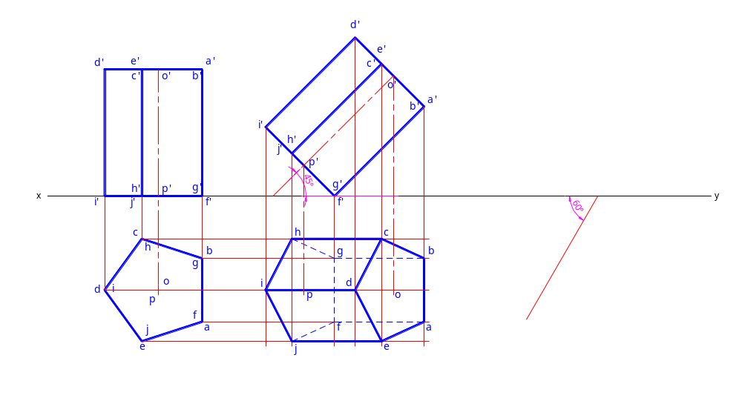
Example 4:
A pentagonal prism of 25 mm side of base and axis 50 mm long, has a side of base in the H.P. and inclined at 60º to the V.P. The axis of the prism is inclined at 45º to the H.P. Draw its projections.

Slide 52
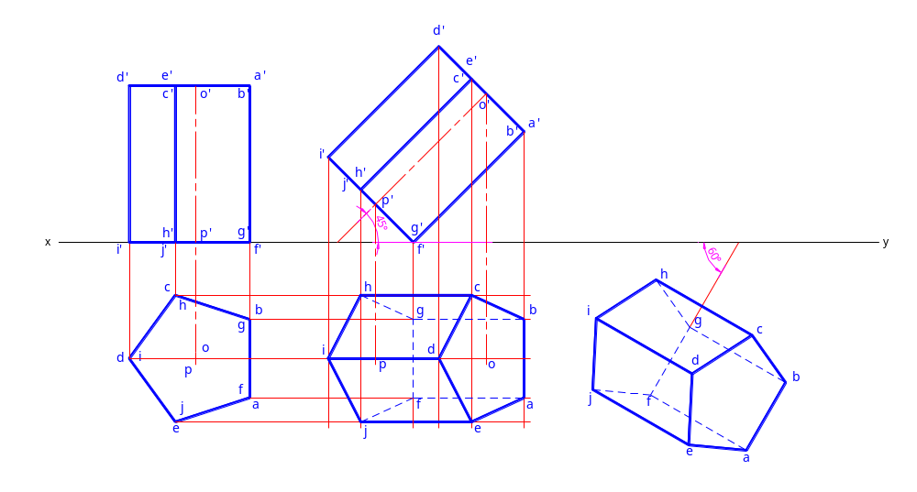
Example 4:
A pentagonal prism of 25 mm side of base and axis 50 mm long, has a side of base in the H.P. and inclined at 60º to the V.P. The axis of the prism is inclined at 45º to the H.P. Draw its projections.

Slide 53
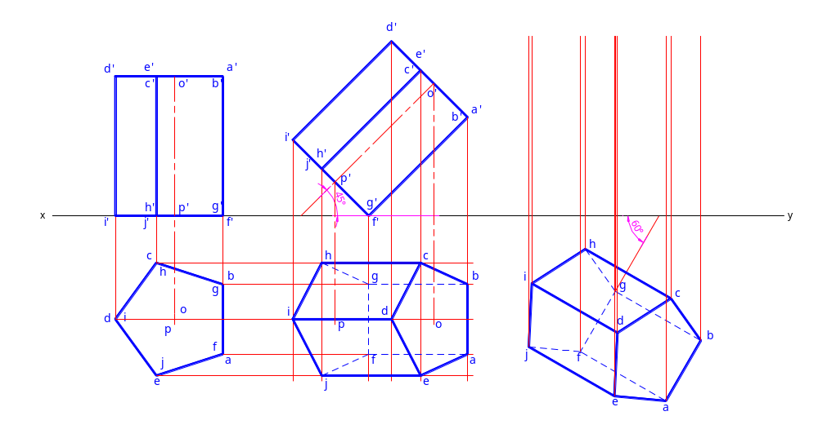
Example 4:
A pentagonal prism of 25 mm side of base and axis 50 mm long, has a side of base in the H.P. and inclined at 60º to the V.P. The axis of the prism is inclined at 45º to the H.P. Draw its projections.

Slide 54
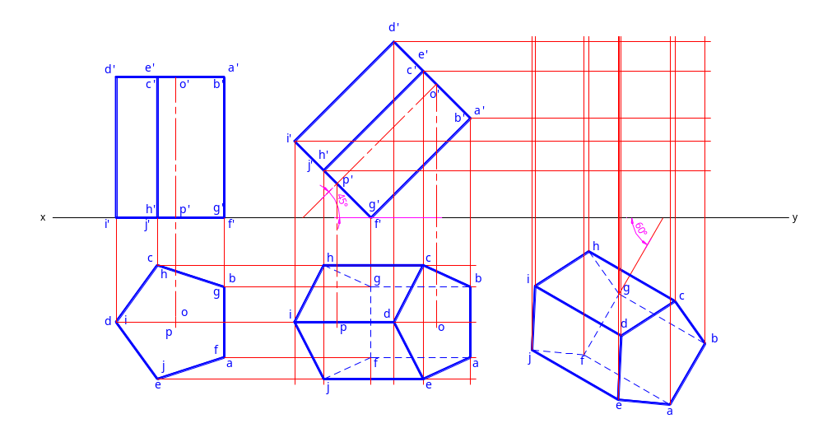
Example 4:
A pentagonal prism of 25 mm side of base and axis 50 mm long, has a side of base in the H.P. and inclined at 60º to the V.P. The axis of the prism is inclined at 45º to the H.P. Draw its projections.

Slide 55
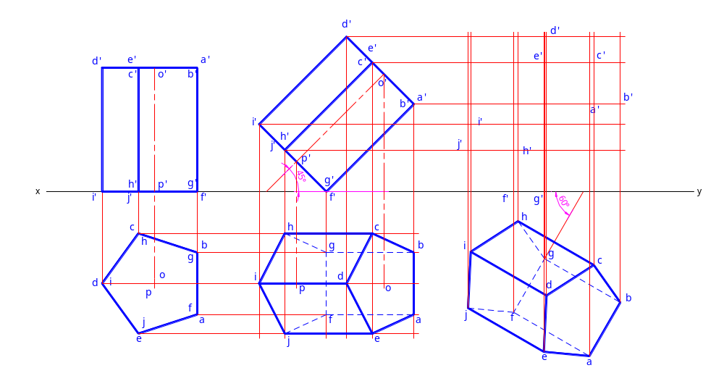
Example 4:
A pentagonal prism of 25 mm side of base and axis 50 mm long, has a side of base in the H.P. and inclined at 60º to the V.P. The axis of the prism is inclined at 45º to the H.P. Draw its projections.

Slide 56
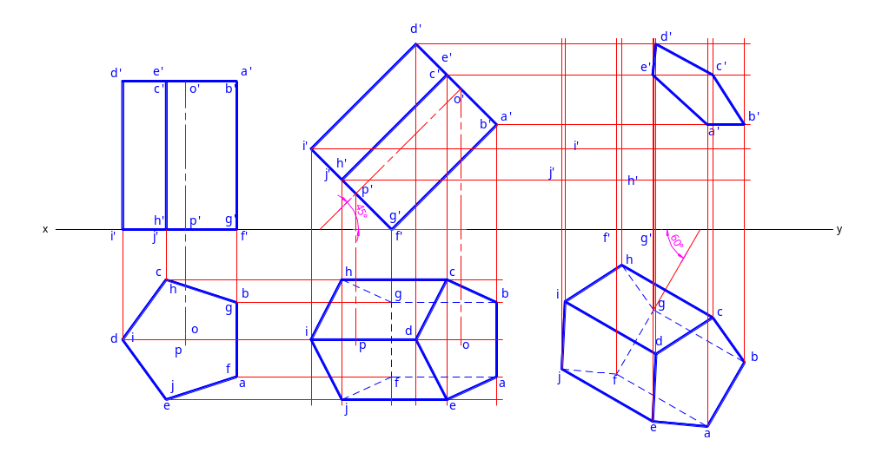
Example 4:
A pentagonal prism of 25 mm side of base and axis 50 mm long, has a side of base in the H.P. and inclined at 60º to the V.P. The axis of the prism is inclined at 45º to the H.P. Draw its projections.

Slide 57

Example 4:
A pentagonal prism of 25 mm side of base and axis 50 mm long, has a side of base in the H.P. and inclined at 60º to the V.P. The axis of the prism is inclined at 45º to the H.P. Draw its projections.

Slide 58

Example 4:
A pentagonal prism of 25 mm side of base and axis 50 mm long, has a side of base in the H.P. and inclined at 60º to the V.P. The axis of the prism is inclined at 45º to the H.P. Draw its projections.

Slide 59

Example 4:
A pentagonal prism of 25 mm side of base and axis 50 mm long, has a side of base in the H.P. and inclined at 60º to the V.P. The axis of the prism is inclined at 45º to the H.P. Draw its projections.

Slide 60
Problem 6.
A hexagonal prism, base 30mm side and axis 75mm long, has an edge of the base parallel to the H.P. And inclined at 45 to the V.P. Its axis makes an angle of 60 with the H.P. Draw its projections

Slide 61
Problem 9:
A square pyramid, base 40 mm and axis 90 mm long, has a triangular face on the ground and the vertical plane containing the axis makes an angle of 45 with the V.P. Draw its projection

Slide 62
Assignment session
Exercise 13(b)
    Problem 1-9
    Page # 309
    N.D. Bhatt 50th / 52nd Edition

Slide 63
Thank You

